Slide 1
Stochastic convergence analysis and parameter selection of the standard particle swarm optimization algorithm
M. Jiang, Y.P. Luo, S.Y. Yang
Information Processing Letters 102 (2007) 8-16
Presenter: Tsung-Jung Tsai (蔡宗容)
Date: May 9, 2007

Slide 2
Abstract
This letter presents a formal stochastic convergence analysis of the standard particle swarm optimization (PSO) algorithm, which involves with randomness. By regarding each particle’s position on each evolutionary step as a stochastic vector, the standard PSO algorithm determined by non-negative real parameter tuple {ω, c₁,c₂} is analyzed using stochastic process theory. The stochastic convergent condition of the particle swarm system and corresponding parameter selection
guidelines are derived.

Slide 3


Introduction - PSO
Particle Swarm Optimization
an algorithm for finding optimal region
based on the social behavior metaphor
Moving in multidimensional space
Adjusting the trajectories of
individual vectors
Global best fitness
υ
Local best fitness
Notes:
● 粒子群最佳化演算法是Kennedy和Eberhart於1995年時提出，在研究PSO的過程中，有各種不同版本出現 [4-9]，也有收斂及最佳參數選定的探討文獻 [10-11]。PSO的概念源自群體行為理論，啟發自觀察鳥群或魚群行動時，能透過個體間特別的訊息傳遞方式，使整個團體朝同一方向、目標而去，是模仿此類生物行為反應來尋求完成群體最大利益的方法。PSO的基本演算模式如下：首以均勻分佈(uniform distribution)隨機產生初始粒子群，每一個粒子都是一個求解問題的侯選解，粒子群會參考個體的最佳經驗，以及群體的最佳經驗，選擇修正的方式，經過不斷的修正之後，粒子群會漸漸接近最佳解。
Reference: http://www.im.ncnu.edu.tw/new/html/now_info/doc/doc/First_FanBen.doc
● 粒子群優法(PSO)是一種模擬社會群體活動行為之智慧演算法，學者Eberhart和Kennedy藉由觀察鳥群飛行與魚群在水中移動的運動規律，在1995年發表關於鳥、魚群覓食行為的粒子群優演算方法。
在粒子群最佳化(optimization)方法中，每一個個體稱為粒子，且每個粒子有各自經驗，經由經驗交換，使得每個粒子能往距離食物點較近的路徑飛去。
Reference: http://210.71.15.19/download2/jjyan/951-Seminar%20¤W½Ò¸ê®Æ/®Ñ³ø°Q½×¸ê®Æ/±iÀ¹©ú_À³¥Î²É¤l¸sÀuªk©óFIRÂø°T.ppt

Slide 4
Introduction - PSO
Global best fitness
P_{global}
(P_{global} – X_{t}) / [(t+1) - t]
= P_{global} – X_{t}
P_{local}
V
Local best fitness
X_{t}
X_{t}
V ’
(P_{local} – X_{t}) / [(t+1) - t]
= P_{local} – X_{t}
X_{t+1}
V

Slide 5
Introduction - PSO
X_{t+1}
distance
Hint: velocity = --------------
time
(P_{global} – X_{t}) × [(t+1) - t]
= P_{global} – X_{t}
V ’
(P_{local} – X_{t}) × [(t+1) - 1]
= P_{local} – X_{t}
X_{t}
V
◆ X_{t+1}= X_{t} + V_{t+1} × [(t+1) - t] = X_{t} + V_{t+1}
◆ V_{t+1}= ωV_{t}+c₁r_{1,t}(P_{local} – X_{t})+c₂r_{2,t}(P_{global} – X_{t})
c₂r_{2,t}(P_{global} – X_{t})
c₁r_{1,t}(P_{local} – X_{t})
X_{t}
ωV_{t}

Slide 6
Introduction - illustration
Local best fitness
Local best fitness

Slide 7
Standard PSO Algorithm
Pupulation size : M
In D-dimensional Space
Particle i
  X_{i} = (X_{i,1}, X_{i,2}, … , X_{i,D}) where i = 1, 2, …, M
  V_{i} = (V_{i,1}, V_{i,2}, … , V_{i,D})
  P_{i} = (P_{i,1}, P_{i,2}, … , P_{i,D}) (its previous best position)
The global best fitness: P_{g}

Slide 8
Standard PSO Algorithm
/* Repeat PSO cycle for InterationLimit times */
for( step = 0; step < IterationLimit; step++ ) {
for( i = 0; i < PopulationSize; i++ ) {
for( d = 0; d < Dimension; d++) {
adjust ω
V^{d}_{i}(t+1) = ωV^{d}_{i}(t) + c₁r_{1,t}(P^{d}_{i local} – X^{d}_{i}(t) ) + c₂r_{2,t}(P_{global} – X^{d}_{i}(t) )
X^{d}_{i}(t+1) = X^{d}_{i}(t) + V^{d}_{i} (t+1)
calculate fitness
update P^{d}_{i local}、P_{global}
}
}
}

Slide 9
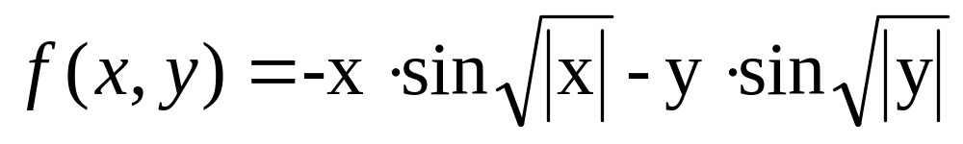
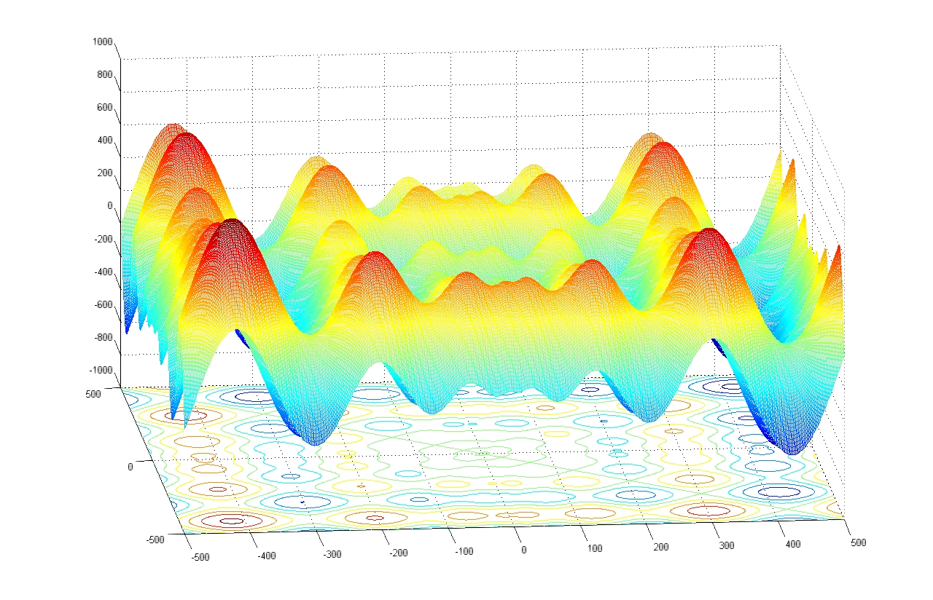

Slide 10
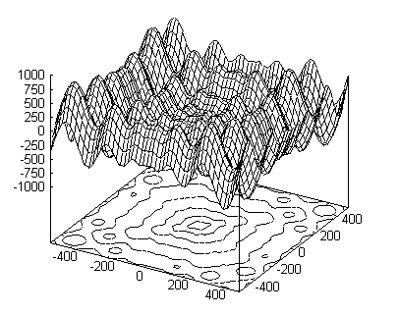
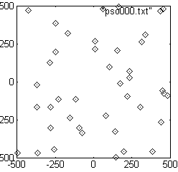
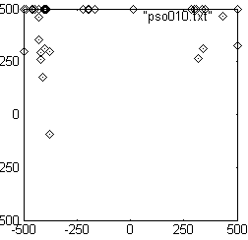
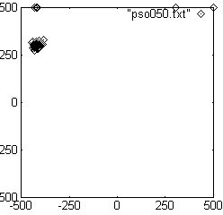
Introduction - illustration

Slide 11
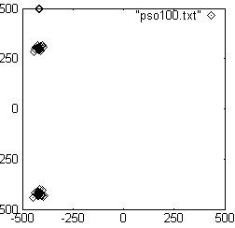
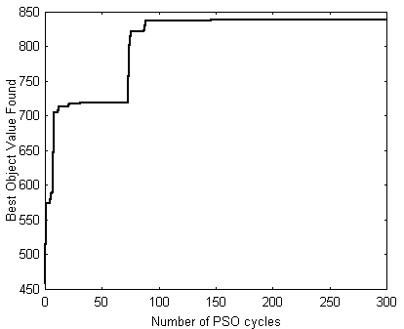
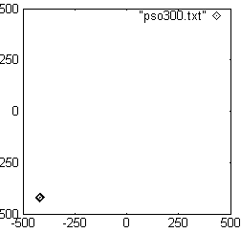
Introduction - illustration

Slide 12
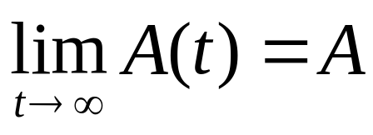
Convergent property
Deterministic sequence {A(t)},
t = 0, 1, …, Convergence refers to the property that the limit
Where A is the convergent value(a constant), and both A(t) and A are scalars or vectors

Slide 13
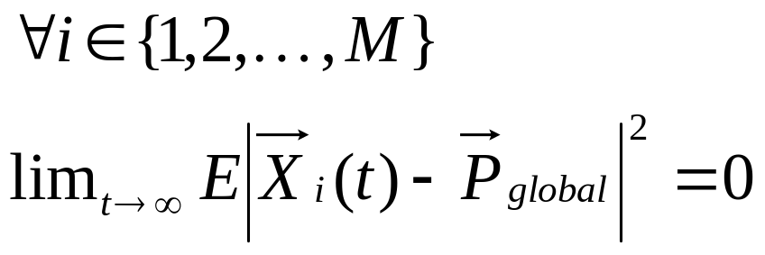
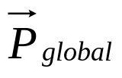
Convergence of a particle swarm
is defined as the property
It is said that the particle swarm system converges to

Slide 14
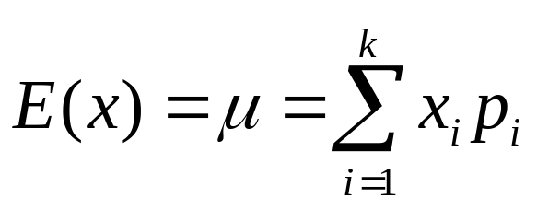
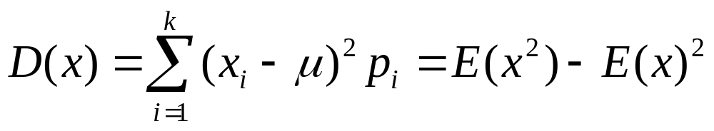
Review expectation and variance
E: expectation
D: variance
Notes:
D: variance 離差(資料值與期望值的差異) 平方和的平均(加權)

Slide 15
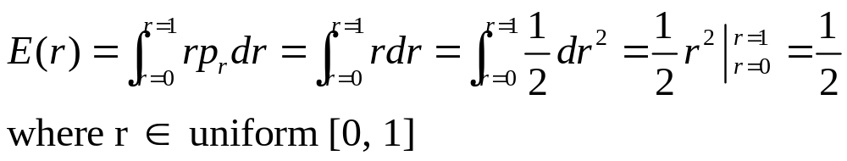
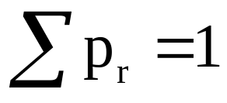
E: expectation
Pr
1
r
0
1

Slide 16
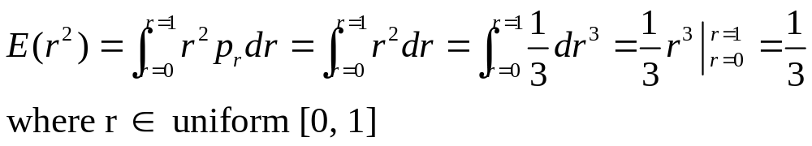
E: expectation
Pr
1
r
0
1

Slide 17
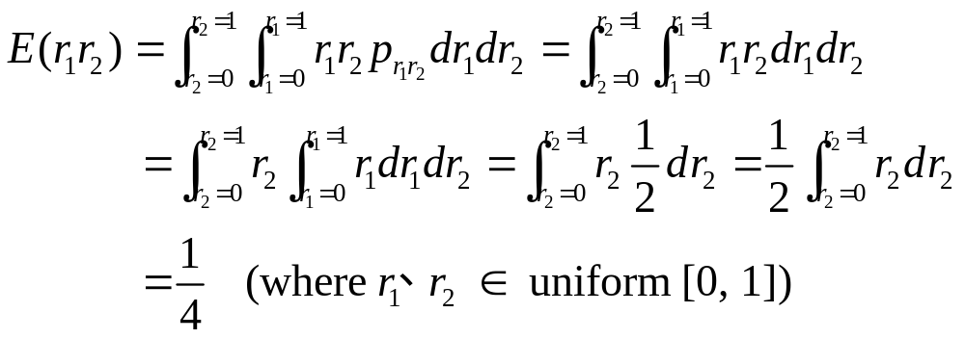
E: expectation
Pr
1
0
r₂
1
1
r₁

Slide 18
How to analyze the standard PSO
Goal:
  Analyze convergence property and the parameter range of {ω, c₁,c₂}
  Fix parameter tuple {ω, c₁,c₂}
  P_{local} and P_{global} keep constant
  All particles evolve independently
  Each dimension is updated independently

Slide 19
Convergence analysis
V_{t+1}= ωV_{t} + c₁r_{1,t} (P_{local} – X_{t}) + c₂r_{2,t} (P_{global} – X_{t})
X_{t+1}= X_{t} + V_{t+1}
X_{t+1}= (1 + ω - (c₁r_{1,t}+c₂r_{2,t}) ) X_{t}
- ωX_{t-1} + c₁r_{1,t}P_{local} + c₂r_{2,t}P_{global}
Each X_{t} should be regarded as a random variable, and the iterative process {X_{t}} should be regarded as a stochastic process.

Slide 20
Convergence analysis of the expectation of particle’s position
Theorem 1. Given ω, c1, c2 ≧0, if and only if 0≦ω＜1 and 0＜ c1+c2 ＜4(1+ω),
iterative process
E X_{t+1}= (1 + ω – (c₁+c₂)/2 ) E X_{t}
– ω E X_{t-1} + (c₁P_{local} + c₂P_{global})/2
λ² - (1 + ω – (c₁+c₂)/2 ) λ+ ω = 0
EX = (c₁P_{local} + c₂P_{global})/(c₁ + c₂)
Notes:
反覆週期（Iterative Process）.

Slide 21
Convergence analysis of the variance of particle’s position
Theorem 2. Given 0≦ω＜1 and ω, c1+c2＞0, then f(1) ＞0 is the necessary and sufficient condition of max{|λ₁|, |λ₂|, |λ₃|} ＜1.
Y_{t} = X_{t} – μ
Y_{t+1} = (ψ – R_{t} )Y_{t} – ωY_{t-1} + Q_{t}
D Y_{t} = E Y_{t}² – (E Y_{t})²
where f(1) = – (c₁+c₂)ω² + (c₁² + c₂² + 3c₁c₂)ω / 6 +
c₁+c₂ – c₁²/3 – c₂²/3 – c₁c₂/2

Slide 22
Convergence analysis of particle’s cognition
Theorem 3. Given ω, c₁,c₂≧0, if iterative process { DX_{t} } is guaranteed to converge and f(1) < c₂²(1+ω) /6, then iterative process { Pi(t) } will converge to P_{global} with probability 1.
EX = (c₁P_{local} + c₂P_{global})/(c₁ + c₂)
DX = ((c₁ + c₂)/(c₁ + c₂))²/6 ×
(P_{global} - P_{local})² (1 +ω) / f(1)
Prob(lim_{t→∞}P_{i}(t)= P_{global} ) = 1
Notes:
「只有認知(cognition-only)」

Slide 23
Conclusions
The analysis results lead to a convergent condition for the standard particle swarm system, and the corresponding parameter ranges.
The result is helpful to understand the mechanism of standard PSO algorithm and select appropriate parameters to make PSO algorithm more powerful.

Slide 24
Future
Some more factors influencing the convergence of particle swarm system are needed to be considered in future.
Further research is also needed to clarify the relationship between PSO performance and parameter selection to guarantee convergence.

